Slide 1
Decentralized robot logistics
Minor adaptive robotics

Slide 2
Table of contents
Goal
Hardware
Design process
Prototyping
Implementation
Software
Decision tree
ROS
Decision logic
Simulation
Real world

Slide 3
Goal
Transport product
Decentralized control
Transfer between robots

Slide 4
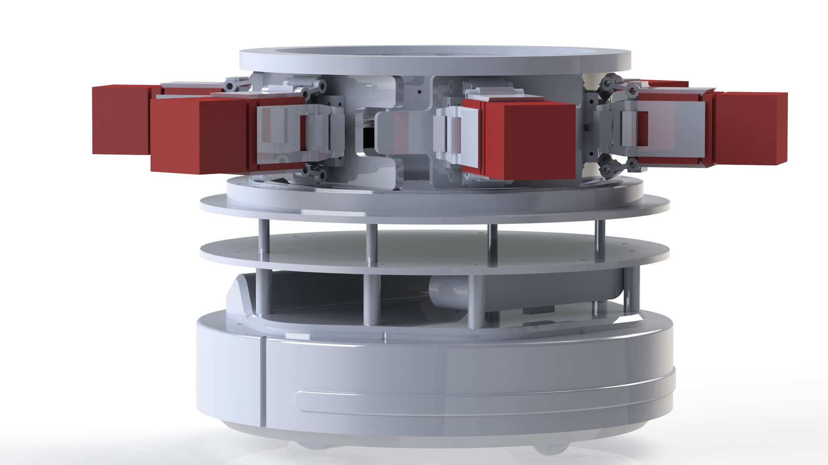
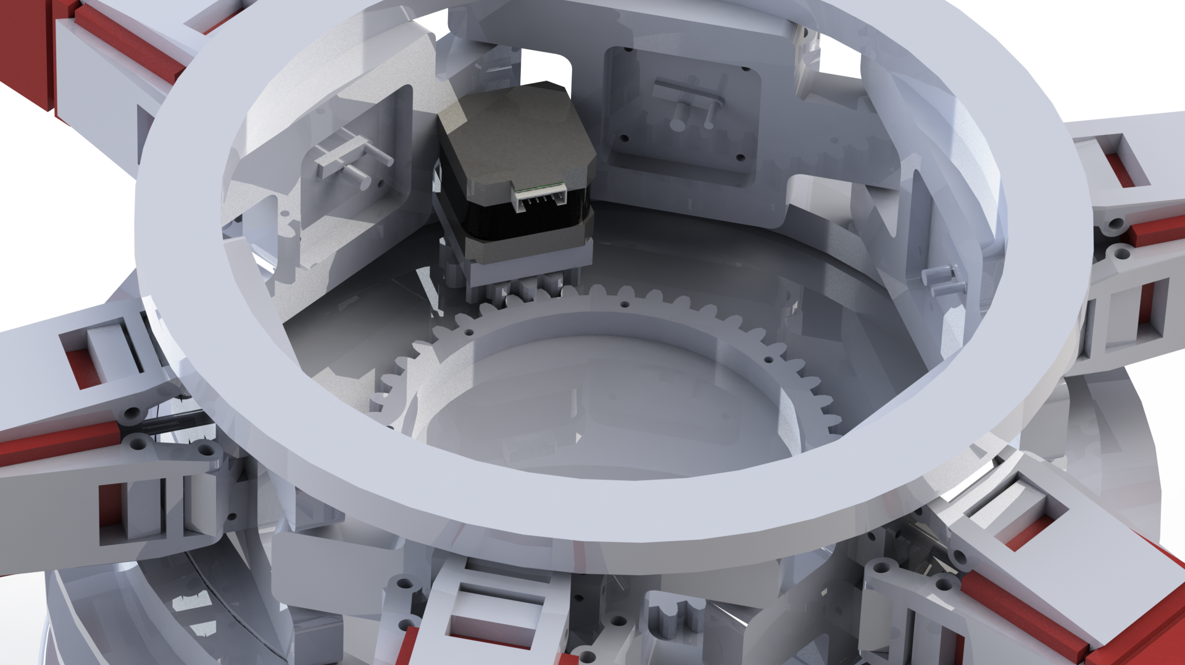
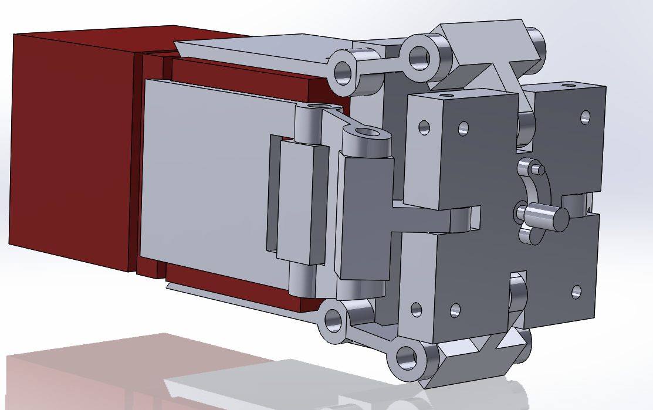
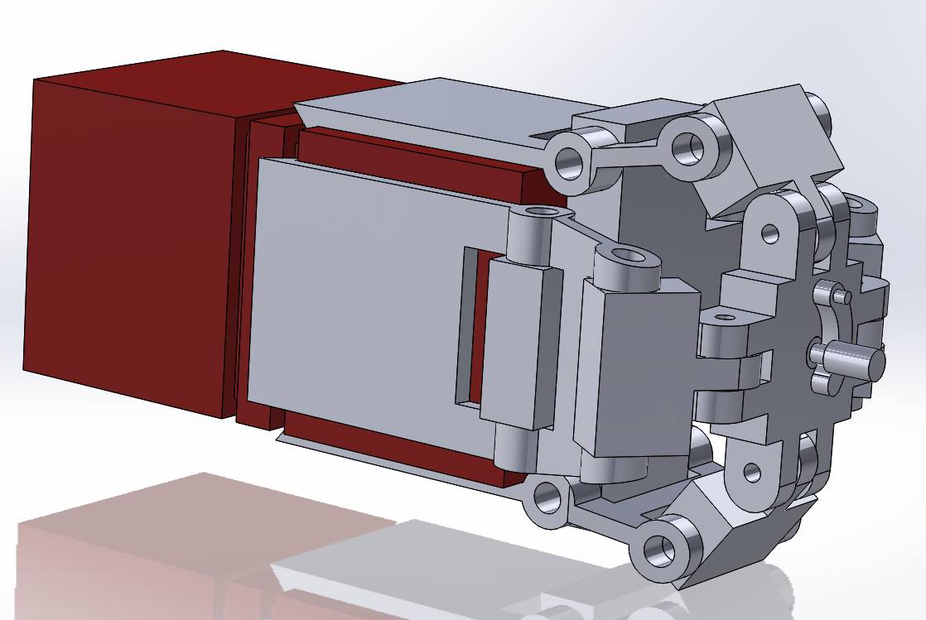
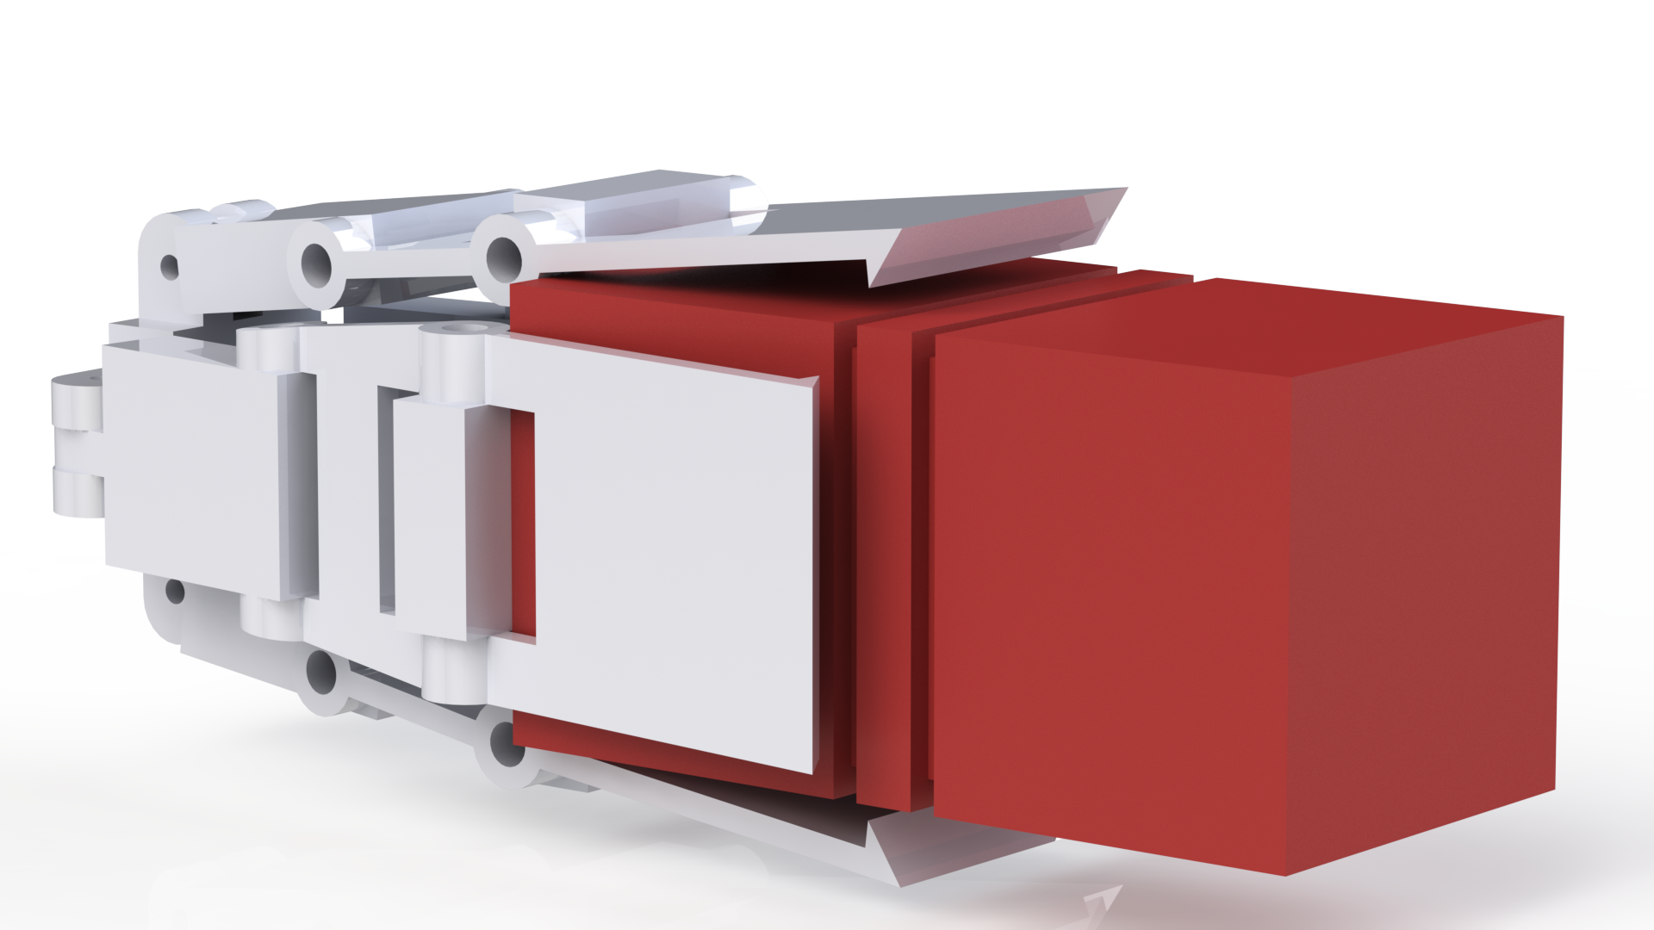
Design process

Slide 5
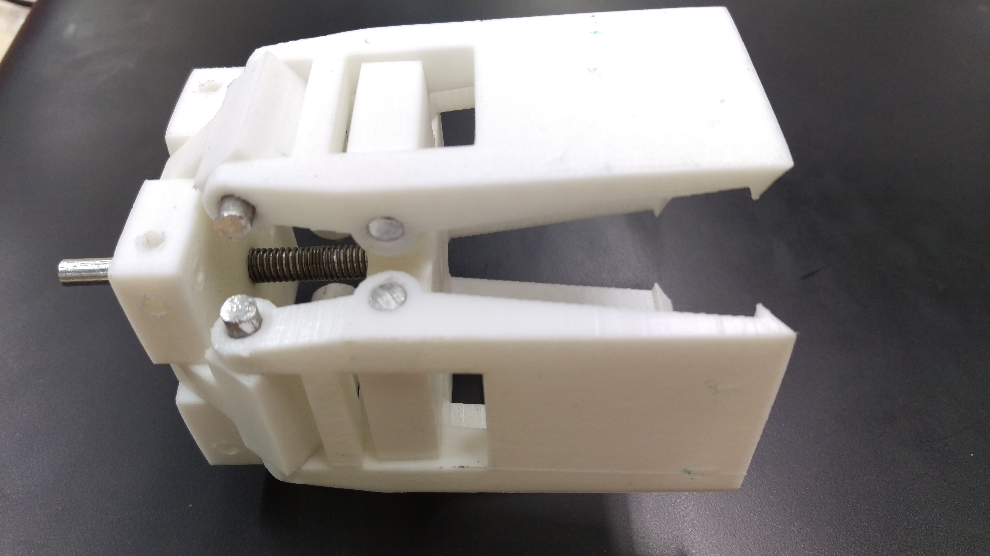
Prototyping

Slide 6
Implementation
1 functional gripper
Rotating system in place
Wiring not complete yet
Should be repeatable

Slide 7
Decision tree

Slide 8
ROS

Slide 9
Decision logic

Slide 10
Simulation

Slide 11
Real world

Slide 12
Conclusion

